Slide 1
Northern Adelaide Irrigation Scheme Community Information Session
August 2015

Slide 2
Welcome
Notes:
Housekeeping
Toilets
Tea, coffee
Evacuation point
We acknowledge that many of you here tonight are concerned about recent actions by SAW to store recycled water in the area.
We’re not here to negatively impact on the environment, business, families.
Tonight is the start – we don’t expect to deliver solutions or outcomes. We want to genuinely explore your issues and concerns. It’s about PROCESS.
At end of night – going to be asking for nominations to work with us on a Committee – we will not get the solution tonight, but to get there we need your help.
We have spoken to many groups and individuals – and there does exist different opinions. We intend to hear everyone's views in a constructive way (seek agreement from audience). If we can’t conduct tonight this way then I reserve the right to shut the meeting down.
A great amount of time and research has been invested in prioritising increased availability of sustainable water for this region.
This project could provide significant opportunities for economic growth for you and your region, but for it to be realised, storage is critical.

Slide 3
Introductions
Northern Adelaide Irrigation Scheme (NAIS) Project Team Representatives
Steve Dangerfield, Senior Manager Stakeholder Engagement
Mark Wilson, Senior Manager Business Development
Gerry Harris, Manager Business Development
Jane Wilson, Stakeholder Engagement Advisor
Georgina House, Stakeholder Engagement Advisor
Chloe Ringwood, Stakeholder Engagement Officer
Notes:
Here tonight are representatives of our Business Development and Stakeholder Engagement Team.
Collectively we are here to work with the community – this is a process and we don’t intend to be able to answer all the questions tonight.
All members of the team will be assisting during the workshop parts of tonight.
Georgina and Chloe will be documenting tonight’s discussion and you will be provided with a record after the conclusion of all information sessions.
Acknowledgements: there are representatives here tonight from:
Mallala Council
Playford Council
Local MP’s

Slide 4
Agenda
Overview of the Northern Adelaide Irrigation Scheme (NAIS) (Current Status) - 20 minutes
Key issues (discussion) – 25 minutes
Identify high priority issues (workshop) – 15 minutes
Coffee Break
Recycled water storage options (presentation) - 20 minutes
Criteria for Success – (workshop) – 20 minutes
Next steps and how you can stay involved and informed – 5 minutes
Notes:
The agenda provides for us to share some information with you.
Plenty of time has also been allowed for you to share your thoughts and have input to this important project.
We will work within the two hours. If we need a bit longer on something we can do that but that will mean we need to pull back in other areas. I will try not to constrain any discussion but will need to keep the agenda moving.
Seek confirmation that this agenda is ok – Are you comfortable to proceed on this basis?

Slide 5
Information Session - Approach
Presentation of information
Two presentations
Hold questions until end
Interactive sessions
Be clear
Don’t repeat issues already raised
Have your say
Be respectful and understanding of different views and opinions
Be passionate, not personal
Notes:
A lot of people have put in a lot behind the scenes. Engagement processes of the extent to which we have organised here don’t happen without a lot of work and energy.
No of letters distributed:
No of sessions held to date with key stakeholders:
No of information sessions to be held (no of people registered):
Intending to form a committee from nominees (more info later about how you can join) to work with SA Water to develop a water storage master plan.
This is an extensive process – and we need your cooperation and support to help us deliver the right outcome.

Slide 6
Givens
SA Water is committed to developing a Master Plan for Recycled Water Storage in the Northern Adelaide Plains that is:
Sustainable
Economic
Enables the growth of primary production by delivering access to more recycled water
Enables additional recycled water (summer and winter) from Bolivar to be accessible to industry
SA Water is committed to engaging with the community and industry to identify and address key issues and seek support for a preferred recycled water storage solution(s)

Slide 7
Overview of Northern Adelaide Irrigation Scheme (Current Status)

Slide 8
Existing Situation
Virginia Pipeline Scheme (VPS)
Existing Virginia Pipeline Scheme (VPS) currently delivers fit-for-purpose recycled water from Bolivar for use by over 400 growers in the Northern Adelaide Plains
The VPS delivers about 17 Gigalitres of water per annum to the Northern Adelaide Plains
The Virginia Pipeline Scheme is at capacity in Summer but there is some capacity in Winter
Notes:
Virginia Pipeline Scheme has been in operation since 1998.
Took about 8 years to reach its full potential.
The Scheme is currently under the ownership and operation of Trility Pty Ltd (formally Water Reticulation Services Virginia, WRSV).
The Scheme is due to transfer to SA Water on 1 January 2018. New contracts are required to be offered to existing customers by 30 June 2017, on the same terms and conditions of the existing customer agreements with the exception of price (15 year term).

Slide 9
Virginia Pipeline Scheme

Slide 10
Existing Situation
Managed Aquifer and Recovery Scheme Two Wells
To make use of the spare Winter capacity of the Virginia Pipeline Scheme (VPS), additional recycled water could be stored for use during Summer
Managed Aquifer and Recovery was identified as a potential storage solution – location identified as being close to VPS
Engaged with industry associations and properties surrounding the selected site in good faith
SA Water undertook bore drilling at Port Gawler Road/Port Wakefield Road (Two Wells) to understand if Managed Aquifer and Recovery was a technically feasible storage solution
Following community concern about proximity to drinking water bores work ceased

Slide 11
Existing Situation
Recognised the need for a thorough community engagement program before proceeding any further
No recycled water has been injected into the aquifer and will not be under the current conditions
Technical assessments undertaken prior to work ceasing has given us valuable information to validate Managed Aquifer and Recharge as a technically feasible storage solution for the area.
Approximately 650 Megalitres of recycled water could have been stored at the site using two bores.

Slide 12
Location of Two Wells MAR and Virginia Pipeline Scheme
Notes:
Site was selected as:
Positioned close to the Virginia Pipeline Scheme and therefore could make use of existing infrastructure to transfer water (whilst the VPS is at capacity during Summer, there is capacity at the extremities of the network during summer)
Positioned in an area with relatively low volume of existing T2 bores (in comparison to other areas)
During summer, everyone in the southern part of the network is taking water, reducing the pressure and creating capacity in the northern areas of the network
By storing winter water and making it available in summer at the northern end of the network it would improve pressure and enable more water to be used (without any significant alterations to the network)
All water planned for injection at this site had customers ready to take the water – demonstrated demand.

Slide 13
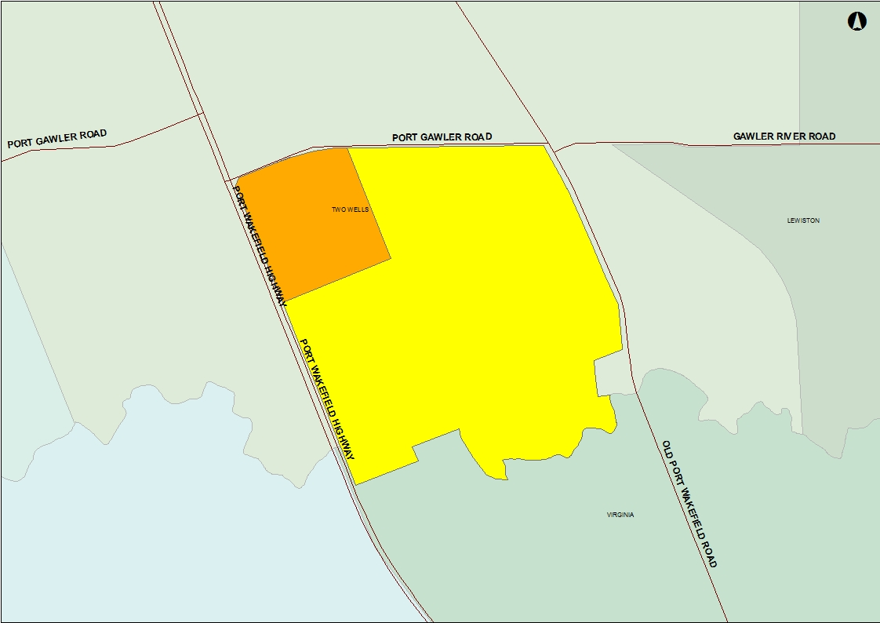
Location of Two Wells MAR

Slide 14
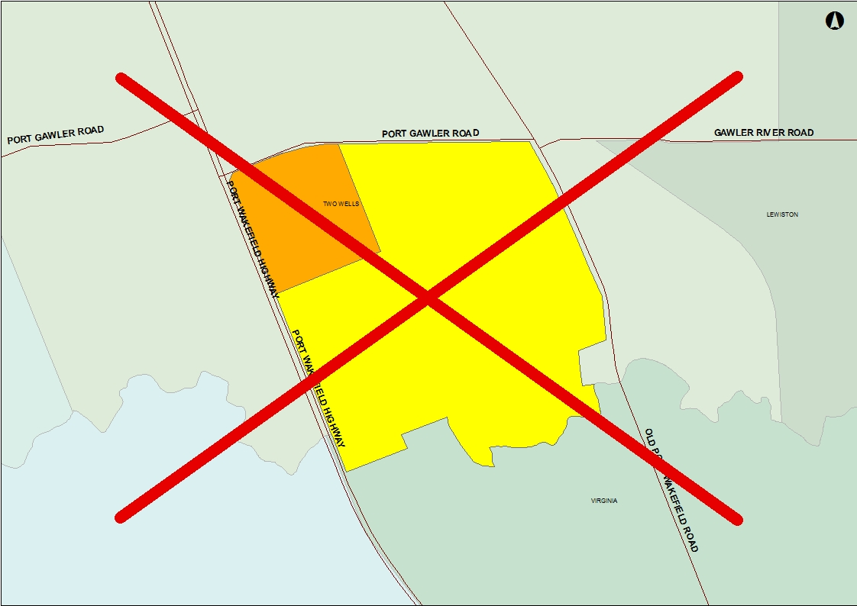
Location of Two Wells MAR
Notes:
After hearing the views of community, we have removed the Two Wells site from the current scope under current conditions.
Forget this site. We have stepped back and intend to start again.

Slide 15
NAIS - Why seek access to more recycled water?
Key Drivers
Economic development – additional recycled water for primary production will enable economic and jobs growth in the region
State Strategic Priority – Premium Food and Wine Produced in Our Clean Environment and Exported to the World
The growing world demand for high quality food and wine, combined with our strong reputation for food safety, biosecurity and product integrity, creates significant opportunities
Consequential Benefit
Environmental – by reducing the volume of treated wastewater discharged to Gulf St Vincent there will be environmental benefits
Notes:
Northern area has been, and continues to see a decline in jobs – closure of Holden, mining activities reducing etc.
State Government is focused on realising economic opportunities in the northern area.
Many other activities occurring including the development of a Northern Economic Plan and establishing Edinburgh as a food export base
The time is now for your region.
NAIS highlighted in Federal Government’s Agricultural White Paper as having potential (only 3 highlighted) making it in the running for federal funding contributions.
Aware of other action plans in the region, including the Horticultural Coalition of SA’s which highlights water security as its number one priority

Slide 16
NAIS – redefined scope
Recycled water produced during the wetter months requires storage to use in drier months
Additional 20 gigalitres of water available:
8 Gigalitres of summer water available dependent upon additional infrastructure
12 Gigalitres of winter water available subject to storage
Without infrastructure and without storage additional recycled water cannot be delivered to the region
There are two broad options for how water may be stored:
Above-ground storage in one or more holding ponds
Below-ground storage to the local aquifer through a process called Managed Aquifer and Recovery (MAR)
Notes:
If required, breakdown of 20 gigalitres:
8 GL from optimising existing tertiary treatment plant
12 GL from new tertiary treatment plant

Slide 17
Community Engagement
Develop a process to enable the community to:
Express their views
Input to SA Water’s decision making
Identify solutions to issues
Share information (local knowledge, technical data)
Deliver a Master Plan for Recycled Water Storage in the Northern Adelaide Plains to enable:
provision of more recycled water to the region
economic development and jobs growth for the State
Notes:
Industry groups – Hortex, Horticulture Coalition of SA, Virginia Irrigators Association, Vietnamese Farmers Associations, AusVeg SA

Slide 18
Community Engagement
Local Government, local industry groups and government agency briefings:
Mallala and Playford Councils
Government Agencies (NRMB, DEWNR, PIRSA, DSD, EPA, Dept of Health)
HortEx, Virginia Irrigators Association,Horticulture Coalition of SA, AusVeg SA, Vietnamese Farmers Associations
Invitations to information sessions – over 4,500
Community information sessions (8 sessions)
Establishment of Community Committee
Regular updates to broader community
Presentation of draft storage master plan

Slide 19
Private Enterprise Engagement
In parallel with the community engagement, private enterprise is being engaged
Proposals will be sought from private enterprise to make use of this recycled water, including provision of infrastructure to transport and distribute, via an Expression of Interest approach to the market
Notes:
Current indications are that there is lots of interest in the market both locally, nationally and internationally
The Expression of Interest is expected to be released in the coming week.

Slide 20
Expression of Interest
“SA Water is currently engaging with the local community to hear their thoughts about the Northern Adelaide Irrigation Scheme, including the different storage options. The engagement process will include information sessions and enable the establishment of a committee to work with SA Water to develop a Master Plan for Recycled Water Storage in the Northern Adelaide Plains.
The outcomes of the engagement process will be provided to shortlisted respondents to facilitate the development of a Selective Request for Proposal (SRFP) response from a stakeholder perspective and it will be expected that the outcomes of this process will inform final proposals”.
Notes:
The following words are a direct quote from the Expression of Interest document.
It is critical that the outcomes of this engagement process, with you community, inform the engagement process with private enterprise with the Master Plan directing how final proposals approach storage – there needs to be alignment.

Slide 21
Engagement Process
Inputs
Community Engagement Strategy for Recycled Water Storage in the Northern Adelaide Plains
Briefings
Minister and Cabinet
Information Sessions
Engagement
Outcome
Government Agencies
Local Government
Local industry groups
Community Committees
Master Plan for Recycled Water Storage in the Northern Adelaide Plains
One-on-one discussions
Site visits
WE ARE HERE
Community updates
Industry EOI
Community Engagement
Expression of Interest

Slide 22
Water Storage Solutions: Key Issues - discussion

Slide 23
1. Community Health and Wellbeing
Concern that the storage of recycled water in the T2 Aquifer will make groundwater unfit for domestic use, including drinking
2. Growing the Local Economy
More water will attract economic growth and job growth for the Northern Adelaide Plains
Concern that the quality of recycled water will affect crop production (for example: salinity of the water; direct or indirect contamination of vegetables through washing or ice packing; potential impact on organic certification)
Opportunity that NAIS could provide water of an improved quality thereby providing high quality products
Concern that NAIS could worsen existing rising water table issues, causing surface flooding and loss of cropping land
Construction of above-ground storage ponds could result in the loss of cropping land
Concern about the future price of recycled water
3. A Sustainable Environment
Concern that more water will increase competition for existing growers
Use of Bolivar wastewater will mean less discharge into the Gulf St Vincent improving the marine environment
4. Confidence in Government Processes and Collaboration
Collaboration of government agencies is needed to achieve best possible water management outcomes
Confidence is needed to ensure all necessary approvals and licenses are in place and that there are regular checks to ensure compliance at all times
Ongoing consultation is needed with the local community, industry associations and growers

Slide 24
Discussion
Discuss and confirm your key issues and opportunities:
Refer to list of issues as a starting point
Expand on existing issues
Add new issues
Notes:
Opportunity for audience to grandstand issues/concerns

Slide 25
Prioritisation of Issues

Slide 26
Group Activity
Which three issues are of highest priority to you?
Discuss key issues
3 sticky dots per person
Place dots against the three most important issues to you
Can place all three against one issue
Notes:
Note to Steve – this was originally sticky dots but given the list of issues/opportunities could be added during the discussion, we thought a numbering system may work better. Happy to change.
Going to need to capture the extra discussion points under the key themes.

Slide 27
Coffee Break

Slide 28
Group Activity
Top three priority issues identified
Notes:
Note to Steve – this was originally sticky dots but given the list of issues/opportunities could be added during the discussion, we thought a numbering system may work better. Happy to change.
Going to need to capture the extra discussion points under the key themes.

Slide 29
Storage
Storage is critical in enabling the Northern Adelaide Irrigation Scheme
Additional 20 gigalitres of water available:
8 gigalitres of summer water available dependent upon additional infrastructure
12 gigalitres of winter water available subject to storage
Without infrastructure and without storage additional recycled water cannot be delivered to the region
There are two broad options for how water may be stored:
Above-ground storage in one or more holding ponds
Below-ground storage to the local aquifer through a process called Managed Aquifer and Recovery (MAR)

Slide 30
Above ground storage
Traditional method of storing water
Approximately 30 hectares of land per Gigalitre of water
Approximately 360 hectares of land required (about 4 square kilometres) to store 12 Gigalitres
Happy Valley Reservoir has a capacity of 12 Gigalitres
Notes:
Above ground storage area has been calculated on a depth of about 8 metres (based on land condition in the area)

Slide 31
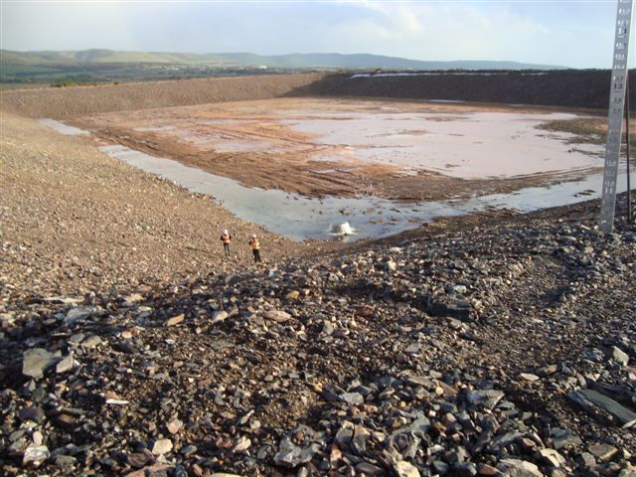
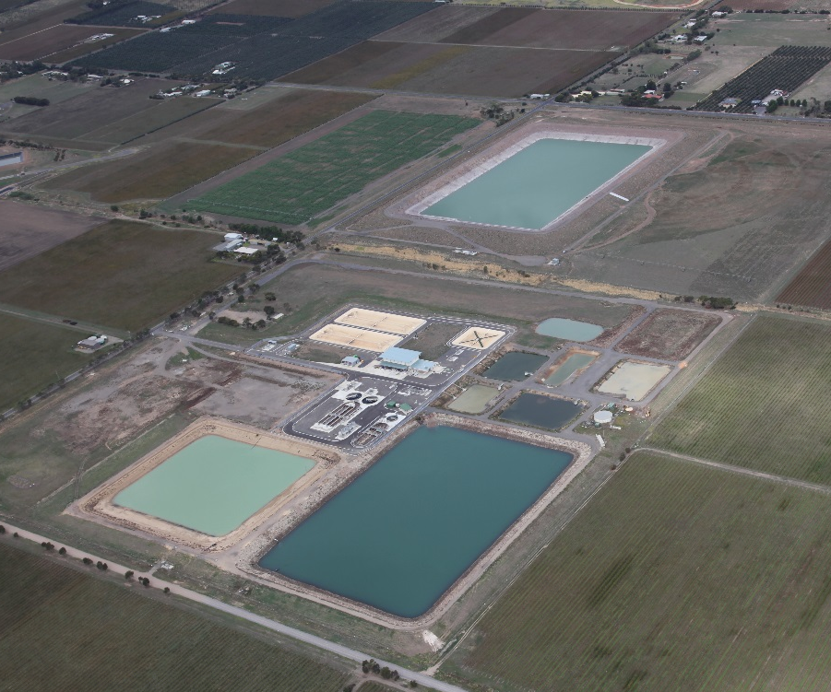
Above ground storage
Aldinga 850 ML recycled water holding pond – 20 hectares, 15m depth
Notes:
850 ML recycled water storage at Aldinga Wastewater Treatment Plant.
Water used for vineyard irrigation – Willunga Basin Water Scheme.

Slide 32
Managed Aquifer and Recovery
Well researched and practiced technology across South Australia, Australia and worldwide
We successfully operate two recycled water MAR schemes at:
Bolivar Wastewater Treatment Plant
Aldinga Wastewater Treatment Plant
Also have stormwater MAR schemes at:
Barker Inlet
Adelaide Airport
Lochiel Park
Notes:
Bolivar Managed Aquifer and Recovery
Constructed in 1997.
Single injection / extraction well.
16 monitoring and observation wells constructed.
CSIRO research project
704ML injected - 501ML extracted between 1997 and 2010
Bores still operational.
Requires more pipe capacity to transfer stored water to customers (only restriction)

Slide 33
Recycled Water Quality
Recycled water from Bolivar has been approved by Department of Health for direct irrigation of food crops
National and State guidelines for best practice water recycling:
Australian Guidelines for Water Recycling: Managing Health and Environmental Risks
South Australian Recycled Water Guideline
Australian Guidelines for Water Recycling: Managing Health and Environmental Risks (Phase 2) Managed Aquifer Recharge
Prior to any recycled water being injected into aquifer, approval is required from:
Environment Protection Authority (license to operate all required)
Department for Environment, Water and Natural Resources
Department of Health
Notes:
Steve note: This was originally intended to be a comparison of different water qualities but there is no simple way to show it without being alarmist (believe me, we tried!). Have come up with the following. Not sure if it needs more. This is really the only slide left that I’m not 100% comfortable with.

Slide 34
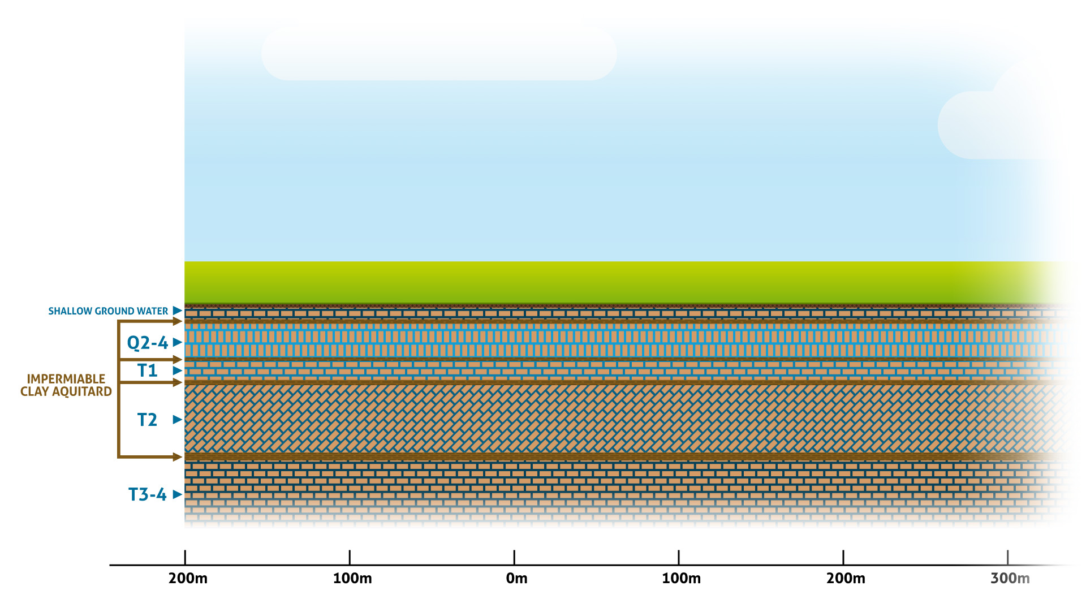
Aquifer structure
Notes:
There are multiple layers of the aquifer – each separated by a layer of clay.
Each aquifer behaves slightly differently
It is not a swimming pool – think of each aquifer as a bucket of sand into which water can be poured – and can move laterally through the sand
Water can also be extracted from the bucket of sand
Between each aquifer there is a layer of clay. These layers are impermeable, meaning that there is no interaction between each aquifer i.e. there is no movement of water between each layer.
Unlike most aquifer systems, water in this region flows into a cone of depression which has come about through years of extraction for primary production use. (most systems flow to the sea)
Water enters the aquifer system in the Mount Lofty Ranges and takes over 10,000 years to move to the Northern Adelaide Plains.

Slide 35
Cone of depression
Notes:
Site was selected as:
Positioned close to the Virginia Pipeline Scheme and therefore could make use of existing infrastructure to transfer water (whilst the VPS is at capacity during Summer, there is capacity at the extremities of the network during summer)
Positioned in an area with relatively low volume of existing T2 bores (in comparison to other areas)
During summer, everyone in the southern part of the network is taking water, reducing the pressure and creating capacity in the northern areas of the network
By storing winter water and making it available in summer at the northern end of the network it would improve pressure and enable more water to be used (without any significant alterations to the network)
All water planned for injection at this site had customers ready to take the water – demonstrated demand.

Slide 36
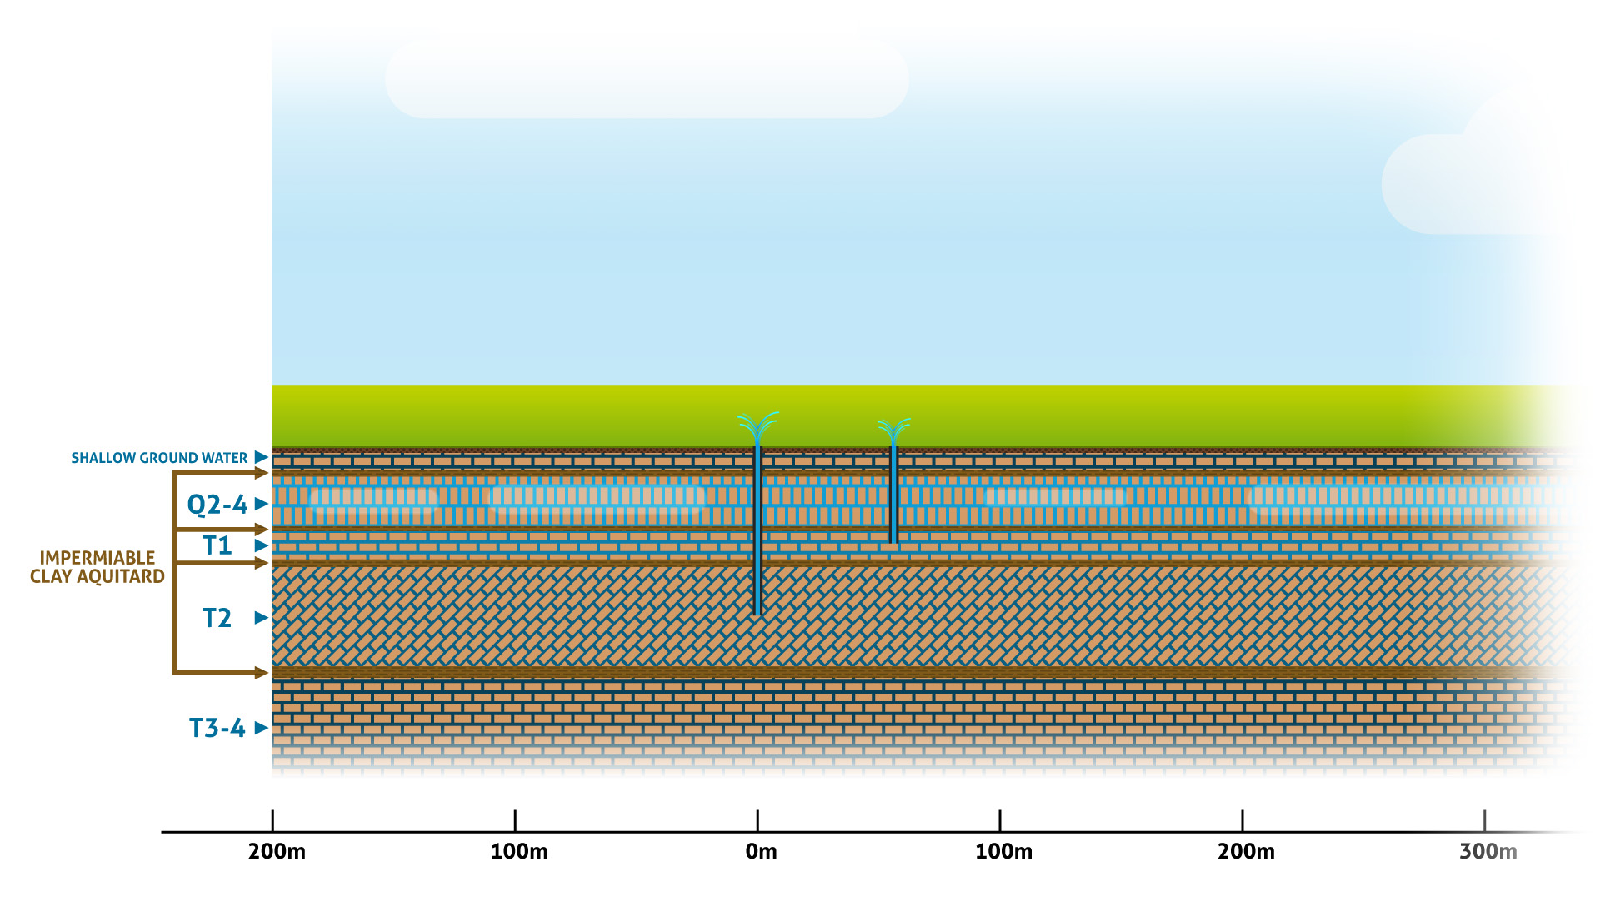
Natural aquifer behaviour
Notes:
Without any extraction (historically)
- If we were to have tapped into the T1 or T2 aquifer for the very first time, this is what you would have seen – strong water pressure pushing up over 10 metres above the ground.

Slide 37
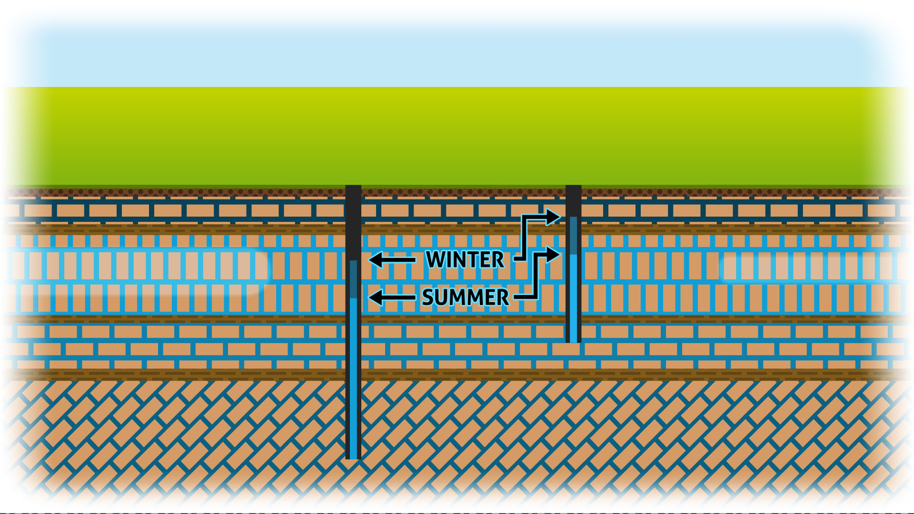
Current situation – without MAR
Notes:
Currently – no MAR scheme
Bores drilled into the T2 and T1 – pressure higher in winter than summer – because there is greater extraction in summer.
This is without a MAR scheme in operation.

Slide 38
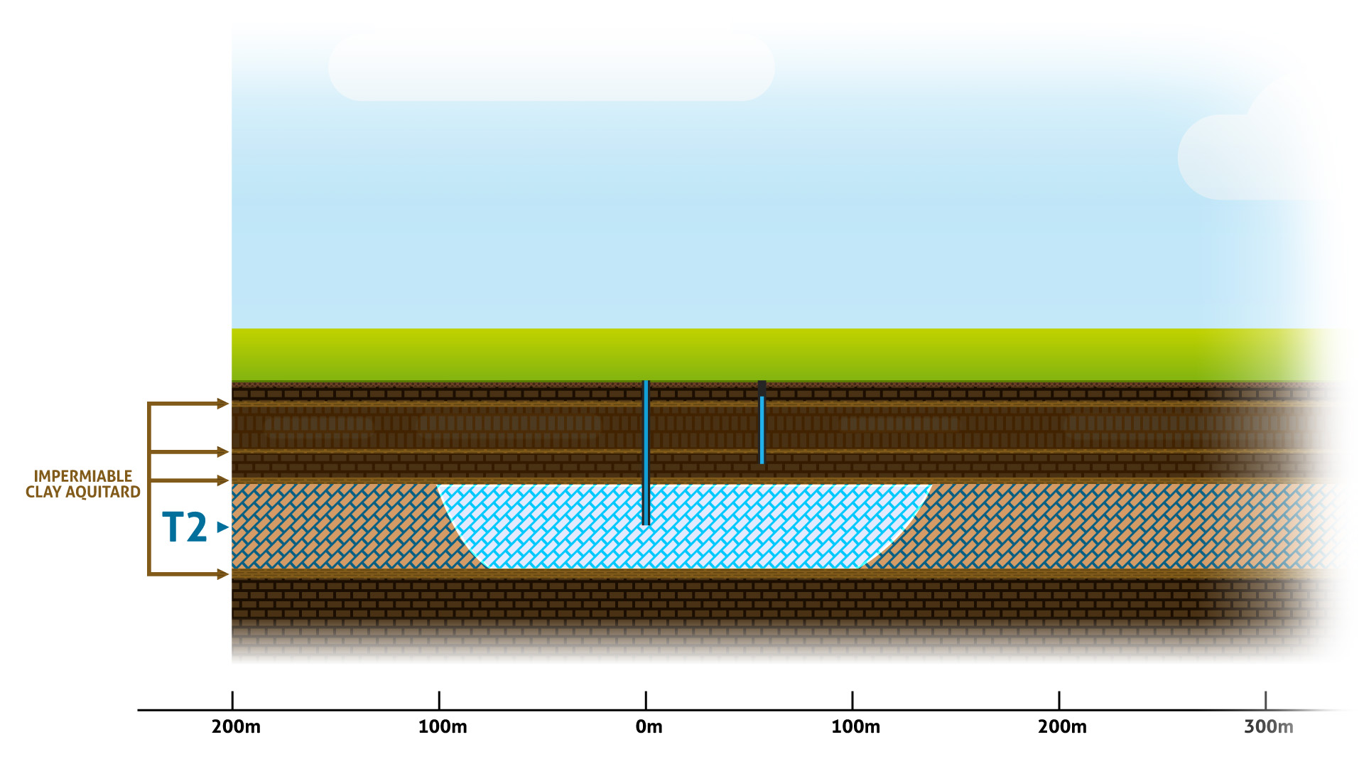
MAR injection
Notes:
We’re now going to focus on the T2 aquifer, which is where any future MAR scheme would access.
All based on Modelling Report of Two Wells Site
This shows the injection cycle during winter – based on injection of 300 mgl.
This shows the extent of the injected water as it would appear in the aquifer. As you can see, there is no interaction with the aquifer above given clay layers.
This ‘bubble’ is formed due to:
the pressure of injection,
Different water densities (between recycled water which is about half the density of native groundwater which is salty)
The bore in the T1 aquifer is there to show that there is no change to pressure than what is currently experienced.

Slide 39
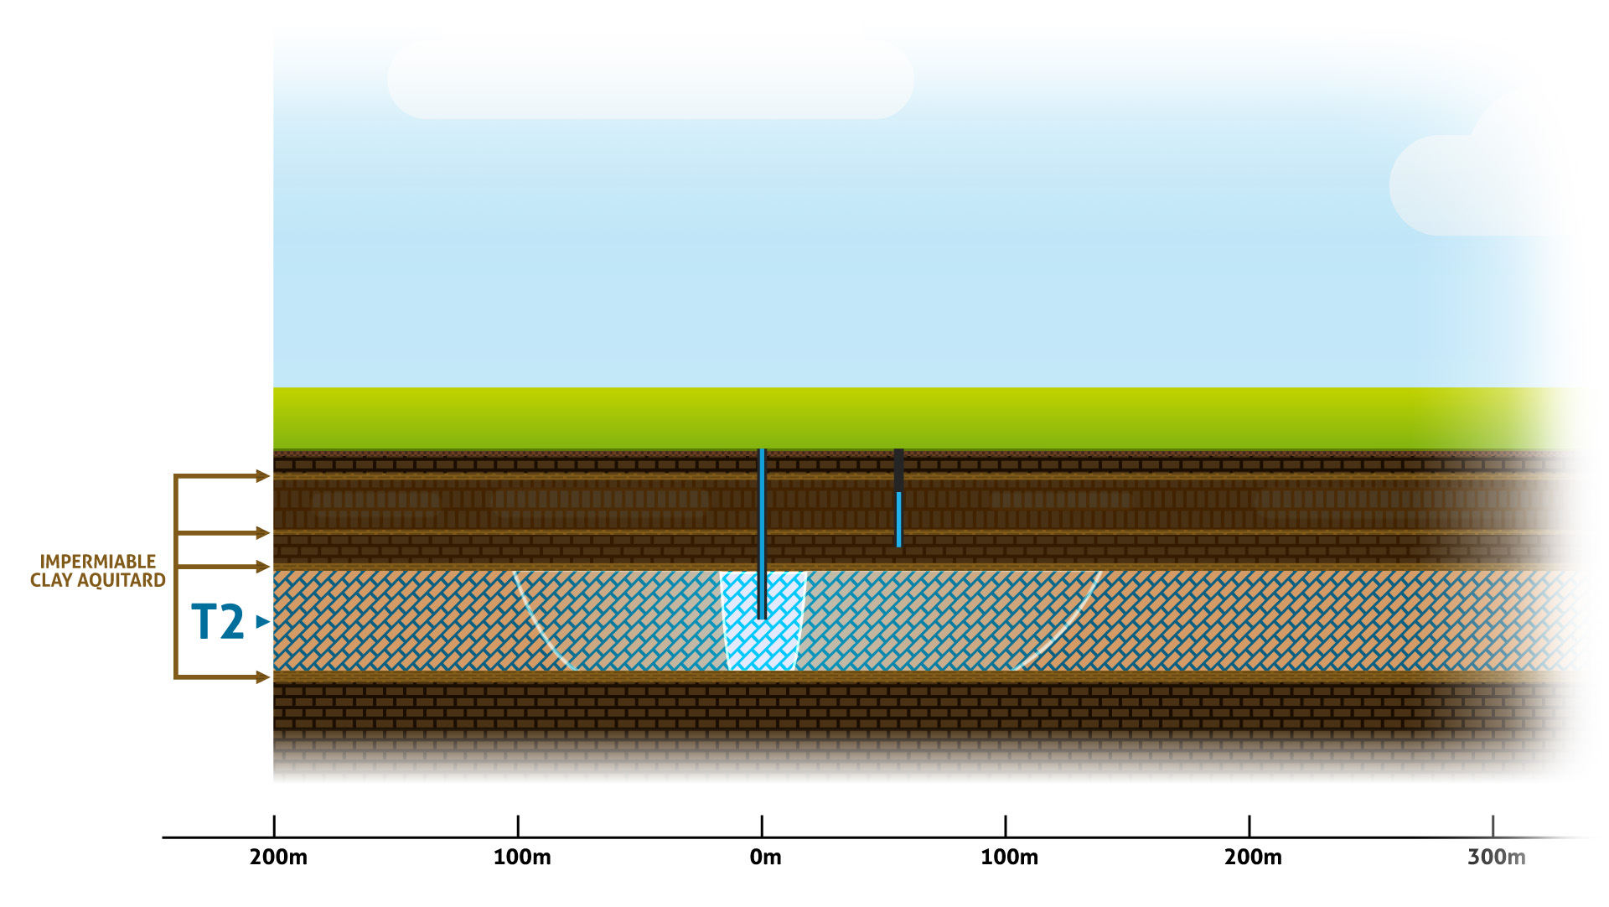
MAR extraction
Notes:
This image shows the extraction cycle during summer.
There is a natural blending of waters at the edges of the ‘bubble’. This means that 85% of water is extracted, 15% remains in the aquifer.
You can see that over one year, the 15% remaining water has moved about 100 metres – more towards the cone of depression
15% stays and moves over time

Slide 40
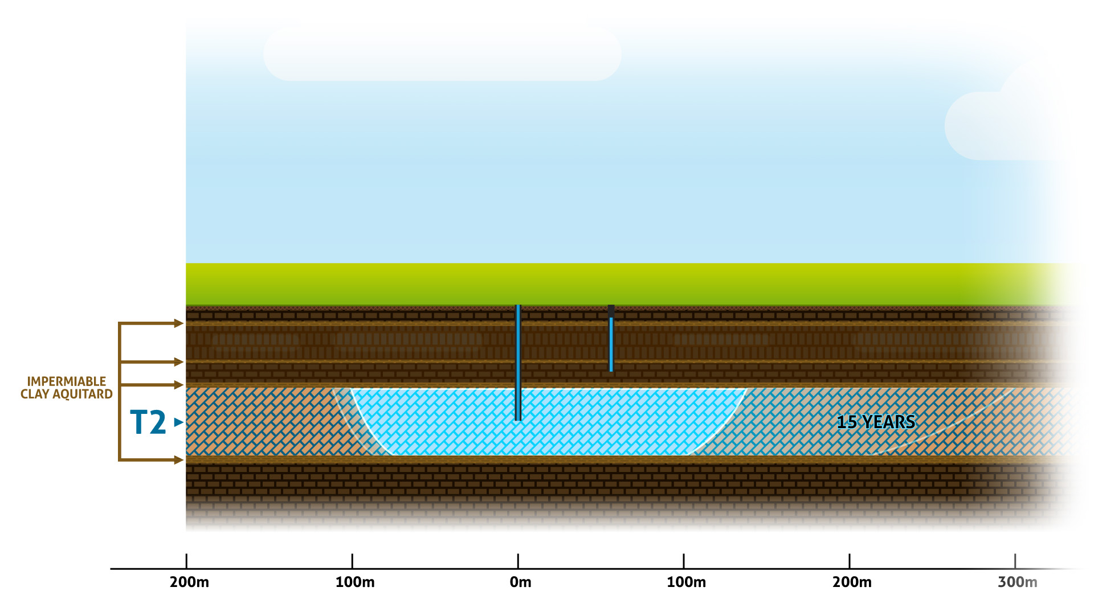
MAR injection at 15 years
Notes:
Injection / extraction for 15 years
At 15 years, the small remaining volume of recycled water has extended 300 metres towards the cone of depression.

Slide 41
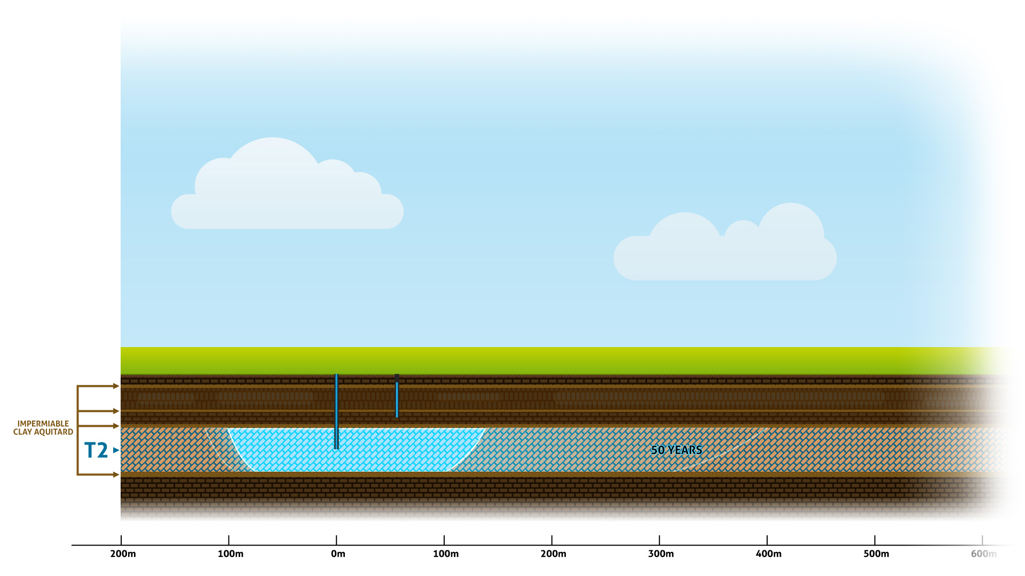
MAR injection at 50 years
Notes:
At 50 years, the small remaining volume of recycled water has extended 400 metres towards the cone of depression

Slide 42
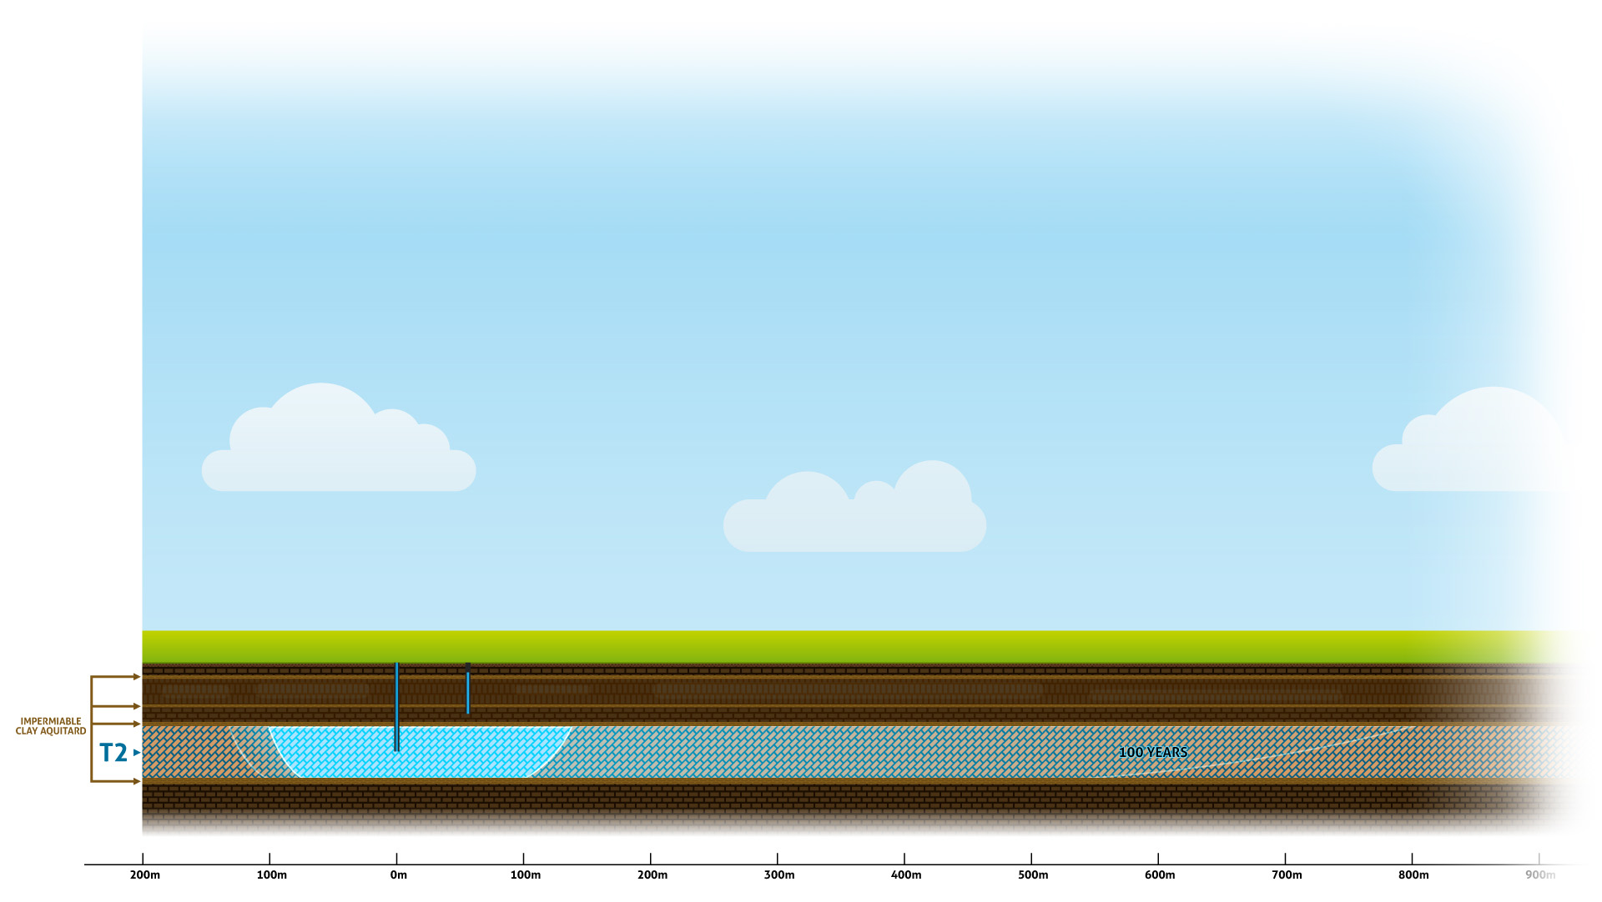
MAR injection at 100 years
Notes:
In 100 years, 800 metres

Slide 43
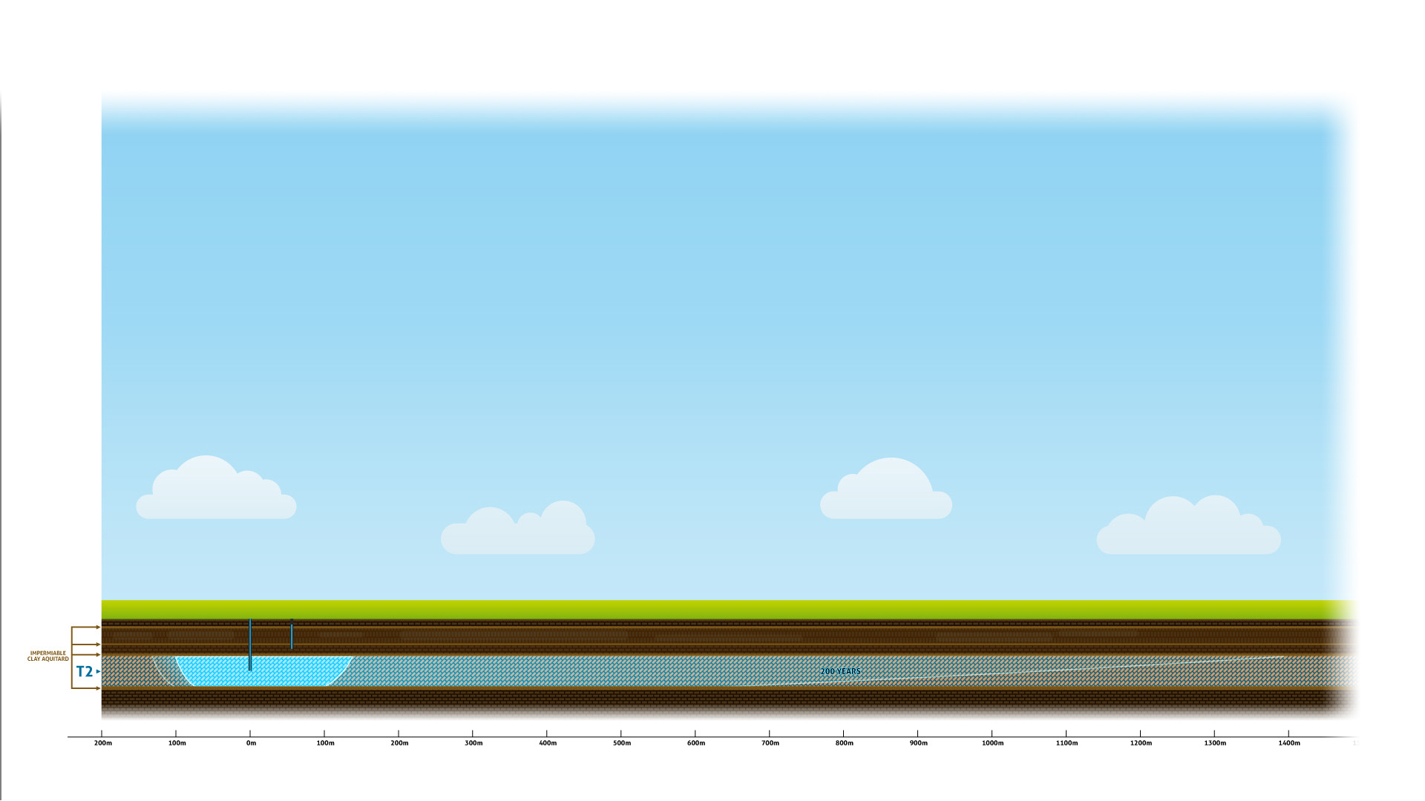
MAR injection at 200 years
Notes:
In 200 years, 1400 metres.
Each year, the remaining recycled water blends with the existing groundwater.
By 200 years, the recycled water would be difficult to detect.

Slide 44
MAR injection over 200 years
Notes:
INJECTION: SUMMARY OF MOVEMENT – over 200 years

Slide 45
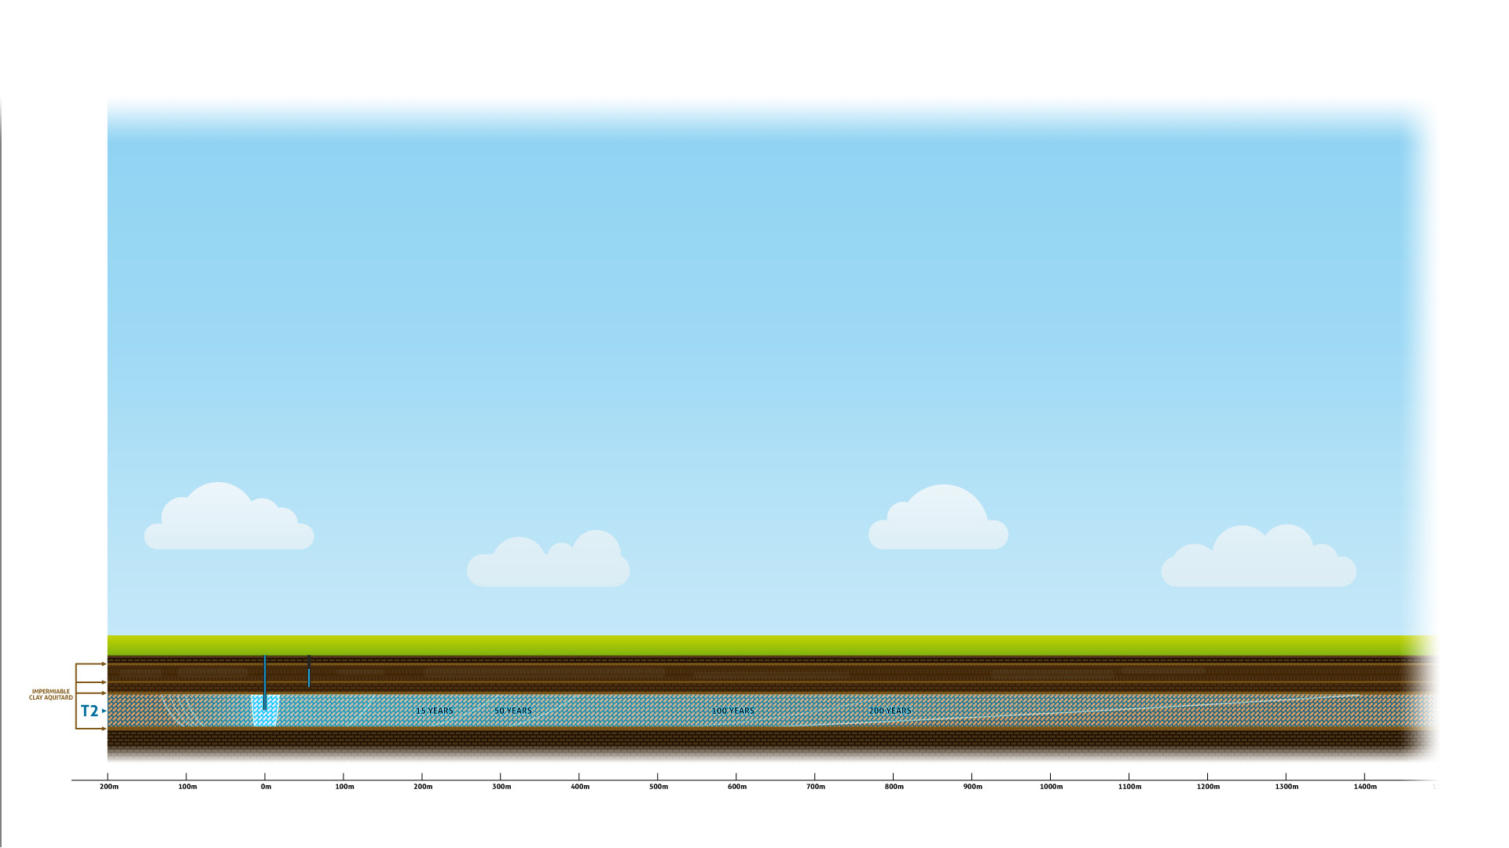
MAR Extraction over 200 years
Notes:
Extraction
To show the movement of recycled water during the extraction phase over 200 years

Slide 46
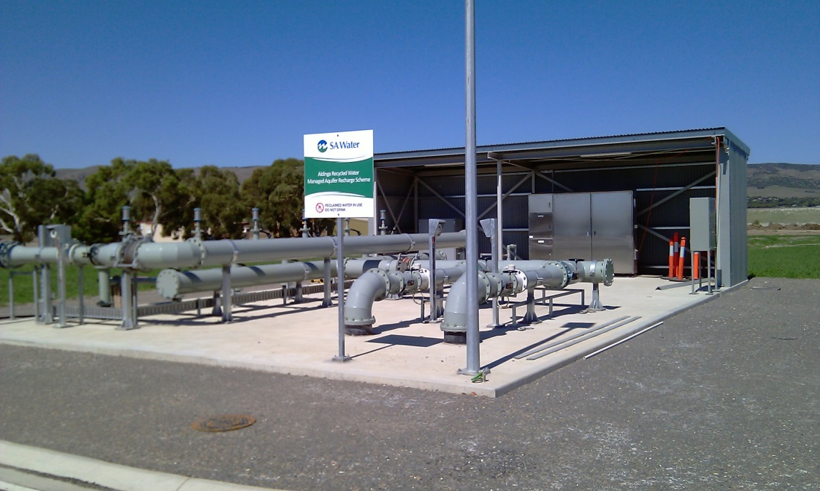
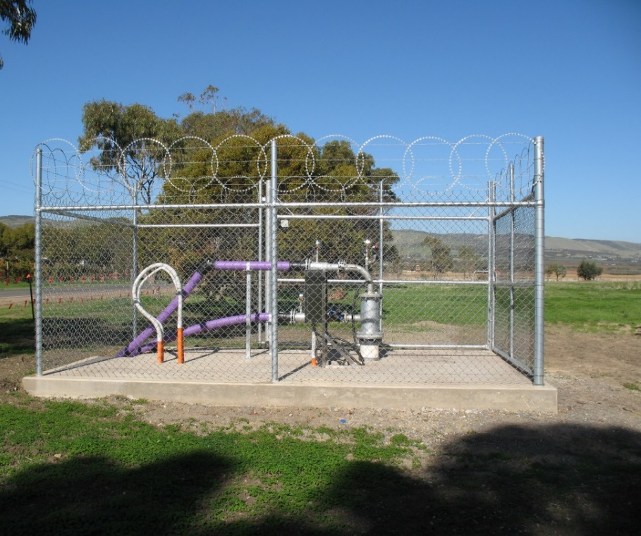
Managed Aquifer and Recharge
Managed Aquifer and Recharge Scheme, Aldinga
Notes:
FOOTPRINT – compared to above ground storage
Example of above ground MAR infrastructure – Aldinga Managed Aquifer and Recharge Scheme
Left – pump station
Right - individual bore

Slide 47
Storage of 12 Gigalitres
To store 12 gigalitres of recycled water using MAR:
Approximately 45 bores located on four separate sites injecting 300 ML per bore
To store 12 gigalitres of recycled water using above ground storage:
Total of four square kilometres of land (across multiple sites)
Management of water quality will require:
Lining
Covers
Further treatment prior to use

Slide 48
Storage options comparison
 | Above ground | Below ground
Evaporation | High | None
Algae | High | None
Midges and mosquitoes | High | None
Stored water quality requirement | Low | High
Odours | Possible | None
Regulatory approvals | Minimal | High
Land required | 40,000 Ha | 400 Ha
Cost (capital ex. land purchase) | High (x3) | Low
Cost (operational) | Low | High (x3)

Slide 49
Success Factors

Slide 50
Activity
What does success look like (inclusive of locations)?
Above ground storage
Below ground storage
Consider issues list
One idea per card
Blue Card – Above ground storage
Yellow Card – Below ground storage
Notes:
Opportunity to provide instructions to the committee for development of master plan.
Chloe and Jane to collate the ideas during activity and pin on board in categories

Slide 51
Next Steps
Establishment of Community Committee
Information from tonight will be collated along with input from other sessions into a report – circulated to all attendees
Regular news-sheet updates on project and committee outcomes
Community Committee meeting agendas and minutes will be made public
Continue to update the community groups and associations
Draft master plan and associated strategies/mitigation measures etc to be made available to community for comment (open house information sessions) prior to finalising
Notes:
Ensure people have provided mail/email details – see Chloe
Community Reference Group forms will be available on your way out. If you are a member of an Industry Association/Group/ Council encourage you to nominate one person to represent

Slide 52
Community Report
Executive Summary
Introduction
Objectives of NAIS
Community Engagement Process
Stakeholders Engaged
Key Engagement Themes
Community Issues
Outcomes and Next Steps

Slide 53
Community Committee
Charter: to develop a Master Plan for recycled water storage in the Northern Adelaide Plains by end 2015
Representation from industry groups, growers, local Council and community members are sought
To nominate to become a member of the Community Committee please complete the form (available tonight)
Community Committee likely to meet every 4-6 weeks to discuss issues and options in more detail, hear technical presentations, assist with Master Plan development

Slide 54
Contact
Jane Wilson
Senior Stakeholder Engagement Advisor
SA Water
Phone: 08 7424 2185
Email: jane.wilson@sawater.com.au
Notes:
For further information

Slide 55
Thank you

Slide 56
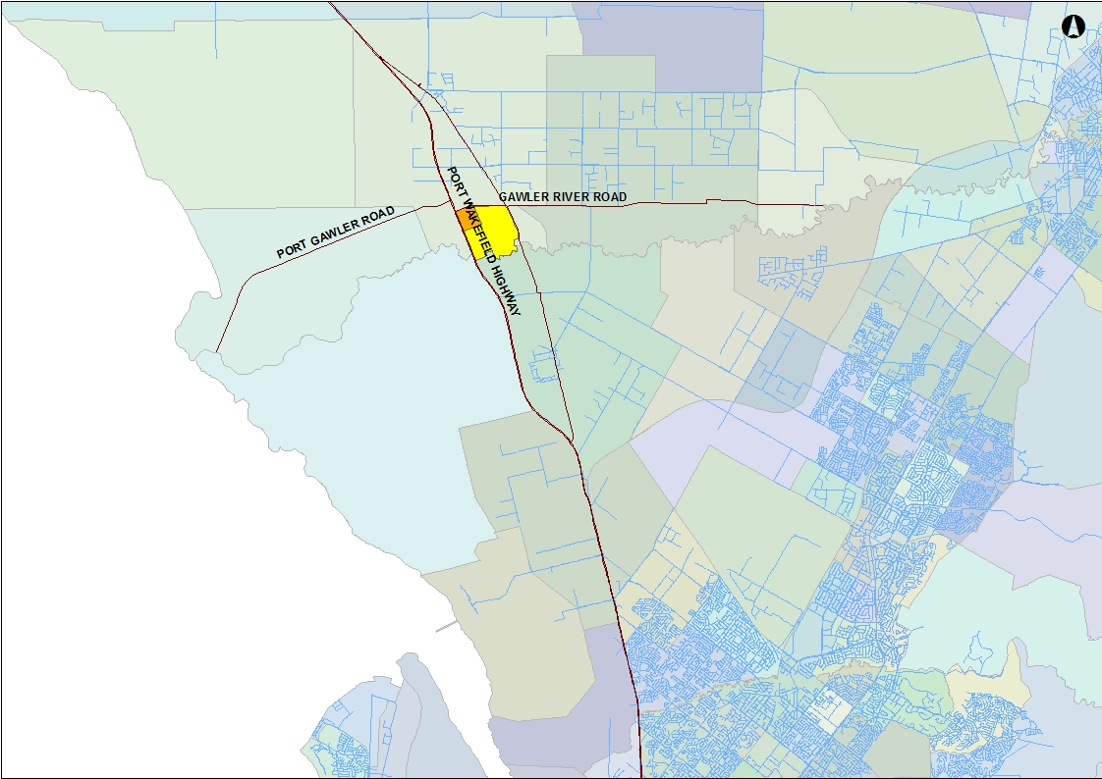
Location of Two Wells MAR with drinking water network
Notes:
Some of you have expressed concern about a MAR scheme being located here as groundwater is commonly used for domestic purpose given there is no mains water supply surrounding the site
This slide shows SA Water’s potable network and the gaps within.
If needed: initially investigations have indicated that approximately 23 kilometres of pipe (and associated infrastructure) would be required to service this area.

