Slide 1
Long Term Plan for Kangaroo Island
Stakeholder Reference Group Meeting 5
15 March 2018

Slide 2
Agenda
10 min
Aaron
Acknowledgement of Country
Welcome and Apologies
Minutes of the previous meeting and Action Items
Update on demand projections
Long list of ideas we’ve collected
Viable options identified
Next Steps
Other Business

Slide 3
Acknowledgement of Country
We acknowledge and respect the traditional custodians of the land on which we meet.
We appreciate and thank them for their care of this land.

Slide 4
Welcome and Apologies
Welcome everyone!
Welcome those attending for the first time.
Apologies received, delegates and information to be shared.

Slide 5
Minutes and Action Items
Minutes of last meeting tabled.
Review of action items.
Feedback on objectives and criteria from those who couldn’t attend last meeting.

Slide 6
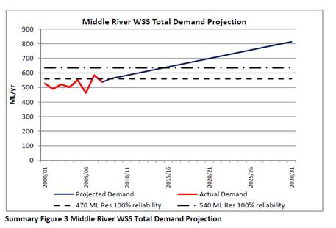
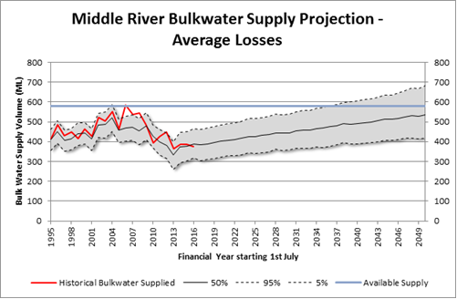
Update on demand projections
20 min
Patrick
2009 plan Prelim updated model circa Oct 2017
2009 plan Prelim updated model circa Oct 2017

Slide 7
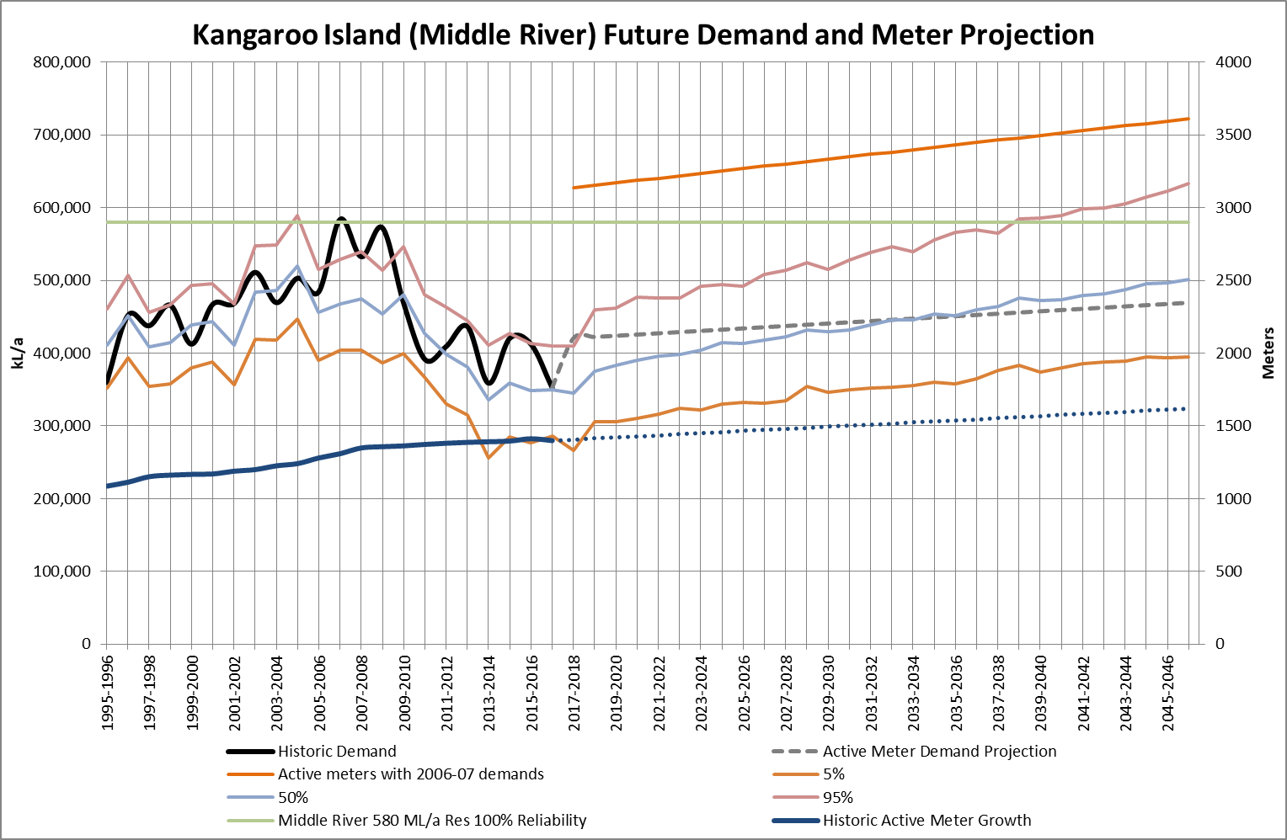
Supply & Demand – Middle River
Projection Assumptions:
Consumption per active connection stable
Using 3 year maximum (not average) demand for active connections
No increase in use from non-active connections
New active connections growth stable
Using past 5 year average is similar to the 3 year average.
Around 6 p/a new residential; 1 p/a new non-residential; and zero new country lands

Slide 8
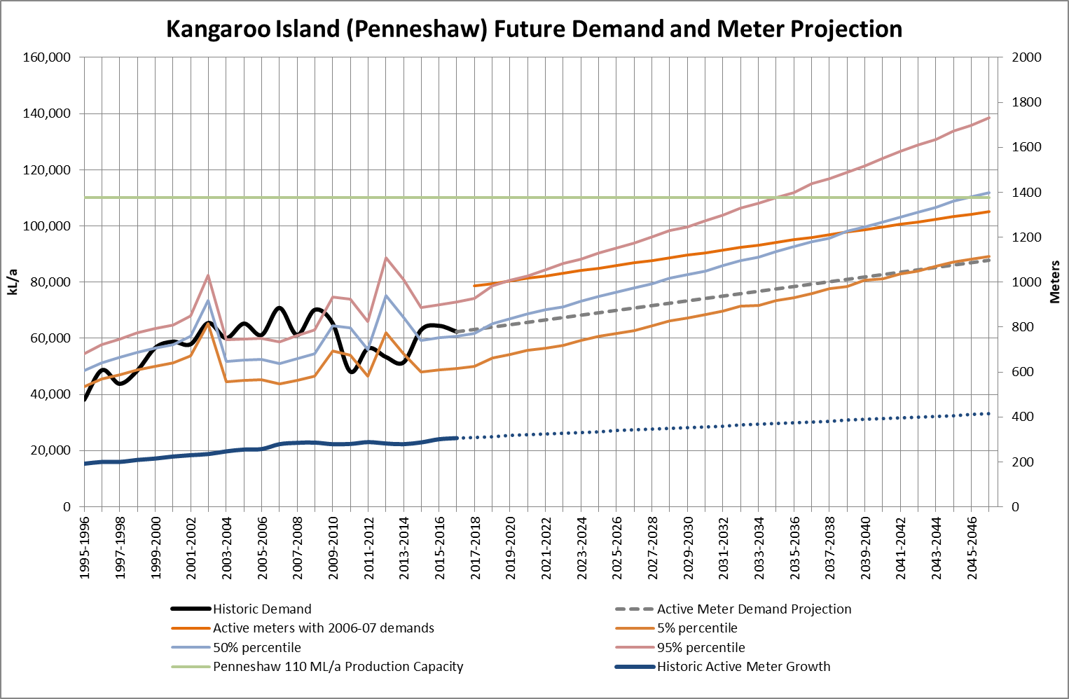
Supply & Demand – Penneshaw
Projection Assumptions:
Consumption per active connection stable
Using 3 year maximum (not average) demand for active connections
No increase in use from non-active connections
New active connections growth stable
Using past 5 year average which is lower than 3 year average
Around 3 p/a new residential; 1 p/a new non-residential; and zero new country lands

Slide 9
Recap: purpose of today’s meeting
60 min
Erin
We’ve collected 70 ideas for how we can serve Kangaroo Island over the long term. Some are aligned to our objectives of security and reliability of supply… and others are more broad.
Today we want your feedback on how we’ve started categorising these ideas and the viable options we’re looking to take forward.
Current State
Future State
Gaps
Possible Solutions
Optimal Solution

Slide 10
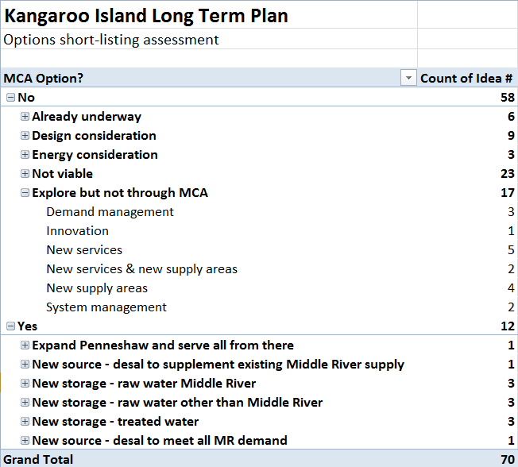
Long list of ideas we’ve collected
Lets look at each category, and get your feedback on our initial assessment of the ideas in to these categories.

Slide 11
Already underway
Feedback please: do these seem fair and reasonable?

Slide 12
Design and energy considerations
Feedback please: do these seem fair and reasonable?

Slide 13
Not viable
Feedback please: do these seem fair and reasonable?

Slide 14
Explore but not through MCA
Feedback please: do these seem fair and reasonable?

Slide 15
Viable options identified for multi-criteria analysis
Expand Penneshaw and serve all from there
New source – desal to supplement existing Middle River supply
New storage – raw water Middle River
New storage – raw water other than Middle River
New storage – treated water
New source – desal to meet all Middle River demand
Feedback please: do these seem fair and reasonable?

Slide 16
Next Steps – rank options
10 min
Erin
Meeting 1-3
What matters to you and the communities you represent
Start confirming objectives and planning assumptions e.g. growth, climate change
Complete confirmation of objectives and planning assumptions
Meeting 4
Understanding the Multi Criteria Analysis approach
Criteria and weightings for evaluating options
Meeting 5 – 15th March
Feedback on possible (shortlisted) options
Meeting 6 – 19th April
Ranking of options and sensitivity analysis to arrive at optimal solution
Feedback on the draft Long Term Plan before wider community consultation in early May
Ongoing - conduit for information to and from the communities you represent
SA Water work on high level design, costing, site location etc

Slide 17
Other Business
10 min
Aaron
Any other business?
What do you need to consult with your communities in advance of next meeting?
Confirm dates and locations for next few meetings

Slide 18
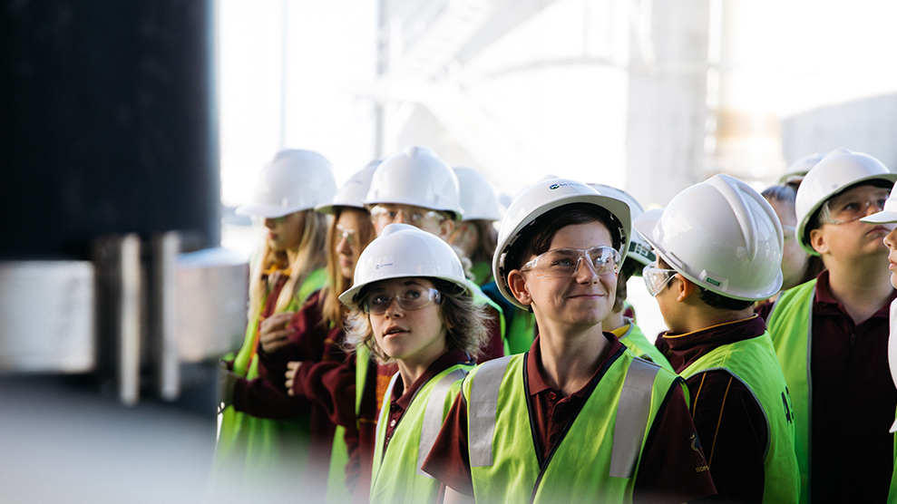
Thank you.

Slide 19
Reference Slides if required

Slide 20
Problem / objectives
ORIGINAL:
• The key risks and opportunities associated with the security and reliability of water supply from source to tap for Kangaroo Island are identified (quantified and or / qualified) and managed, and
• The preferred solution is safe, cost effective, secure and technically and environmentally sound to support the current and future viability of the communities and industries in KI.
REVISED:
• The key risks and opportunities associated with the security and reliability of water supply from source to tap for Kangaroo Island are identified (quantified and or / qualified) and managed, and
• The preferred solution is safe, cost effective, secure and technically and environmentally sound to enable the current and future viability of the communities and industries in KI.

Slide 21
REVISED CRITERIA - all
Red text indicates what has changed
Category | % | Main criteria | % | Sub criteria | % | Strategic intent
Environment | 25 | GHG emissions | 10 | GHG footprint | 100 | Minimise Greenhouse Gas (GHG) emissions from both construction and operation
 |  | Terrestrial & aquatic ecosystem | 75 | Signifiant habitat, vegetation and fauna | 50 | Minimise impacts on significant vegetation and fauna
 |  |  |  | Inland and marine | 50 | Minimise impact from increased flows / waste into receiving aquatic ecosystem including sea and inland waters e.g. brine disposal
 |  | Heritage | 15 | Significant heritage | 100 | Minimise impacts on significant Federal, State, Local and indigenous heritage
Social | 25 | Security of supply | 40 | Peak system demands | 50 | Maximise ability to maintain reliable pressure and water supply in peak demands (current and future)
 |  |  |  | Source water accessibility | 50 | Maximise ability to access water source without precluding other stakeholders and uses e.g. agriculture, non customers and key critical services
 |  | Customer and community acceptability of options | 40 | Impact on amenity | 10 | Minimise potential for ongoing and/or emerging impacts from “by products” from operation e.g. dust, noise, light pollution, amenity loss, impacts on tourist etc
 |  |  |  | Impact on access to energy | 30 | Minimise the risk of further impacting the constrained energy (power) available to the island
 |  |  |  | Economic growth, security & new customers | 40 | Maximise opportunity for economic growth and water security; and facilitate access potential for new customers/communities
 |  |  |  | Acceptability of drinking water taste & odour | 20 | Minimise the potential for customer dissatisfaction with drinking water taste and odour
 |  | Customer and community safety | 20 | Public health | 100 | Minimising the risk of health impacts to customers and community
Economic | 25 | Cost | 100 | Total cost to supply customer | 100 | Maximise efficient investment ensuring prudent use of financial resources
Technical | 25 | Operational complexity | 25 | Ease of operation and flexibility | 100 | Minimise operational risks from complexity of systems [current and future]
 |  | Complexity | 25 | System complexity | 100 | Minimise functionality risks due to complexity of systems [current and future]
 |  | Reliability | 50 | Functionality / redundancy | 100 | Maximise functionality and resilience of infrastructure [current and future]

